Slide 1


Context
In-house Data Scientist from MOH
The semi-technical audience are stakeholders and doctors.
The stakeholders presented to us an issue about being able to detect potential of stroke as early as possible in A&E with health information gathered at the registration and triage.
We were not given patients’ data due to privacy, so we had to source from elsewhere.

Slide 2
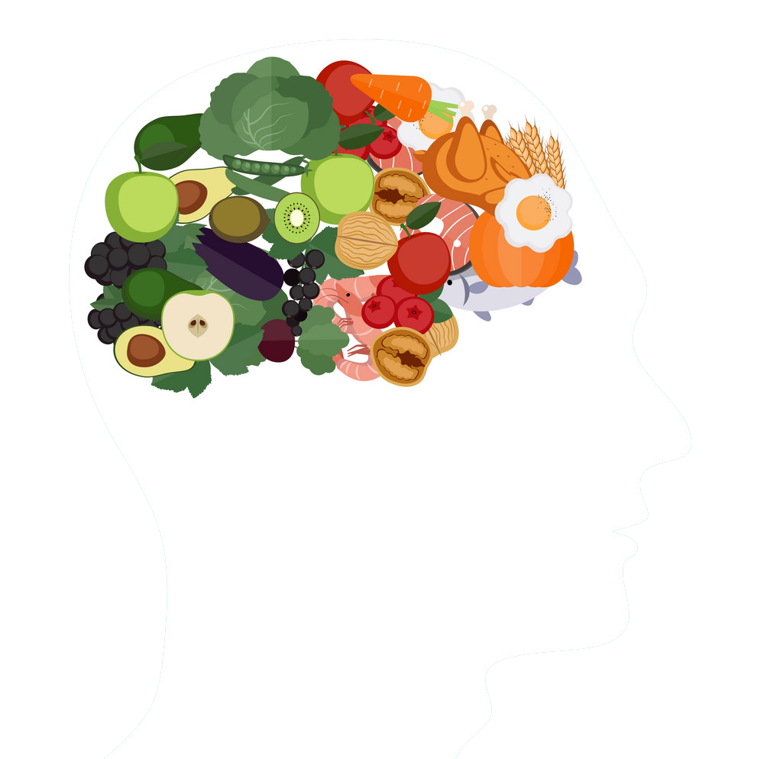

01 Introduction
DSI-SG-42 | Michael King Sutanto | Eugene Matthew Cheong | Pius Yee

Slide 3
Obesity and Stroke
01 Introduction
DSI-SG-42 | Michael King Sutanto | Eugene Matthew Cheong | Pius Yee

Slide 4
Being categorised as overweight increases your risk of stroke by 22% and if you are obese that risk increases by 64%. This is because carrying too much weight increases your risk of high blood pressure, heart disease, high cholesterol and type 2 diabetes which all contribute to higher stroke risk.
-World Stroke Organization
01 Introduction

Slide 5
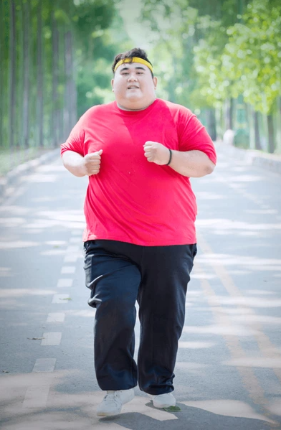
Bernard Tan
A&E Patient
A 40-year-old male stands at 175cm tall and weighs 130kg, feeling uncertain about whether his weight poses risks for obesity or stroke.
He suddenly experienced sudden numbness on the arm, and felt giddiness and headache.

Slide 6

01 Introduction
George, 38
A&E Doctor
He understood that Bernard was experiencing numbness for that short period. And George knows that Bernard’s weight might be a concern for risk of stroke. Due to the lack of resources and high volume of patients that he needed to attend to, he gave some medication and told to be more active, exercise and monitor the situation.

Slide 7


Slide 8
01 Introduction
Ischemic Stroke
An ischemic stroke occurs when a portion of the brain is deprived of oxygen and essential nutrients due to a blockage or reduction in blood supply. This deprivation leads to the rapid death of brain cells within minutes.

Slide 9
01 Introduction
Problem Statement
The healthcare system faces a challenge in quickly identifying patients at risk of stroke upon arrival at the emergency department (A&E), despite standardized triage protocols. Swiftly discerning stroke risk based on initial health particulars such as obesity is difficult, leading to delays in referrals to specialists for preventive measures.
How might we help A&E identify patients at risk of stroke easier?

Slide 10
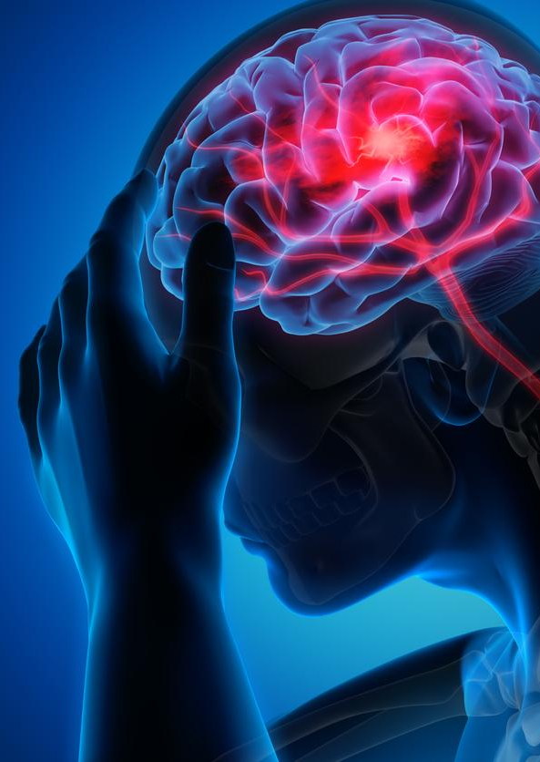
01 Introduction
A Solution Needed
There's a need for a streamlined system using detailed patient information, such as better classification of obesity status, to improve stroke risk assessment during triage, allowing A&E physicians to refer at-risk patients promptly and reduce the likelihood of stroke occurrence.

Slide 11
01 Introduction
Bernard
Application
George

Slide 12
01 Introduction
Machine Learning Models
Application
Obesity Classification Model
Stroke Detection Model
CT Scan Image Stroke Detector

Slide 13
01 Introduction
Bernard
George
Obesity Classification Model
Stroke Detection Model
CT Scan Image Stroke Detector

Slide 14
01 Introduction
Bernard
George
Obesity Classification Model
Stroke Detection Model
CT Scan Image Stroke Detector

Slide 15
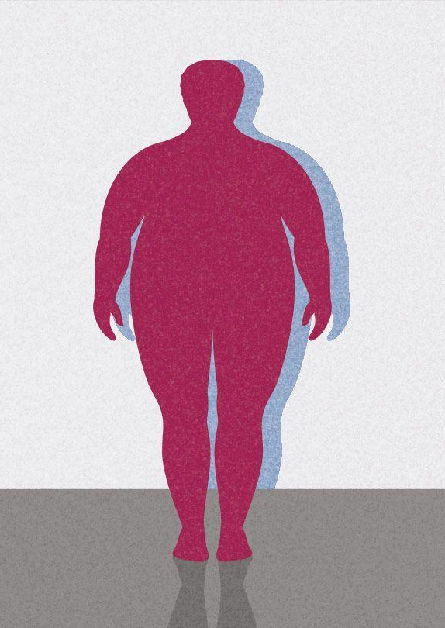
Obesity Dataset

Slide 16
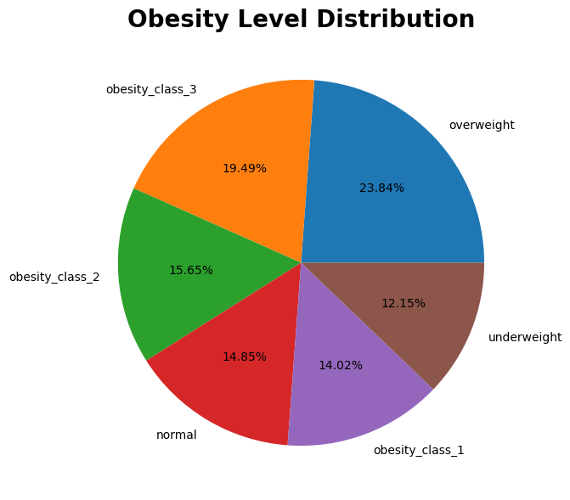
Obesity Dataset
02 Obesity Model
Dataset was taken from Kaggle.
Dataset has around 20,000 rows.
Obesity Status distribution is quite balance.

Slide 17
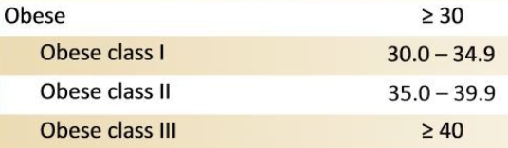
BMI?
02 Obesity Model
Body Mass Index is a person’s weight in kilograms divided by the square of height in meters. A high BMI can indicate high obesity.

Slide 18
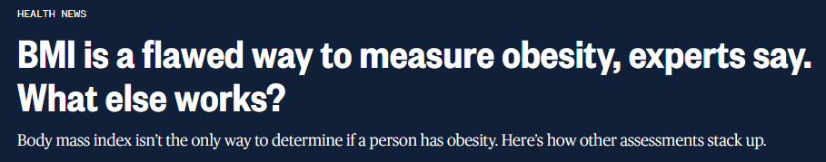
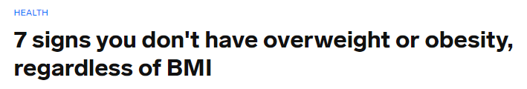
BMI?
02 Obesity Model
www.nbcnews.com
www.businessinsider.com

Slide 19
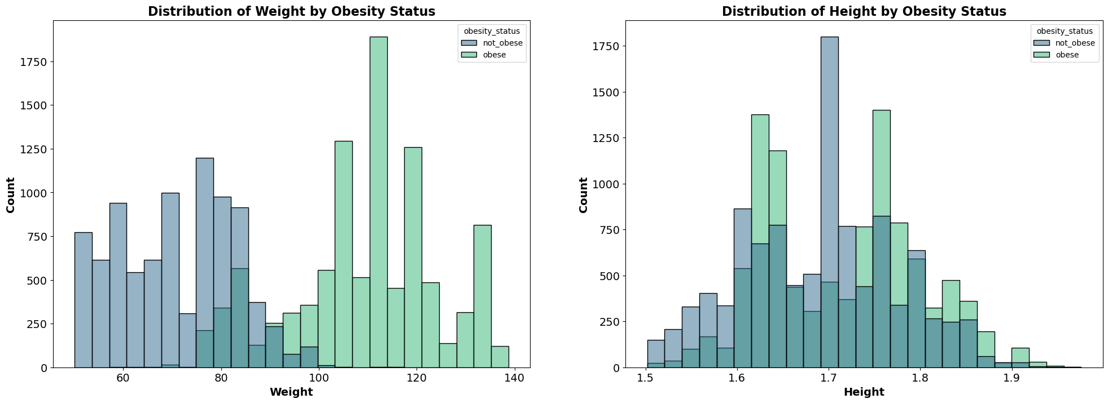
02 Obesity Model
Weight and Height Distribution by Obesity Status

Slide 20
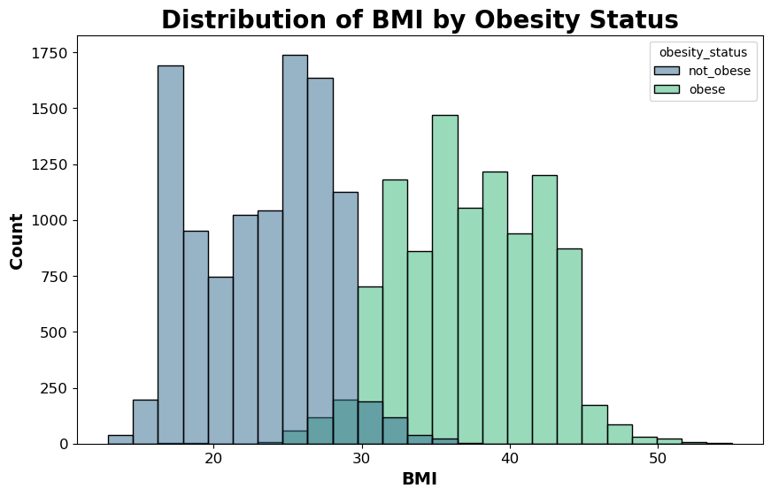
BMI Distribution by Obesity Status
02 Obesity Model

Slide 21
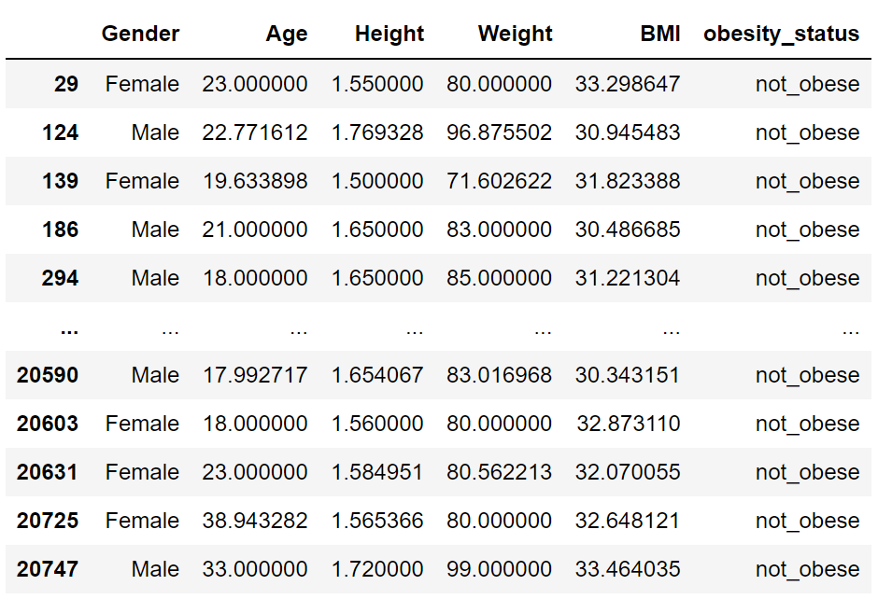
BMI Above 30 and Not Obese

Slide 22
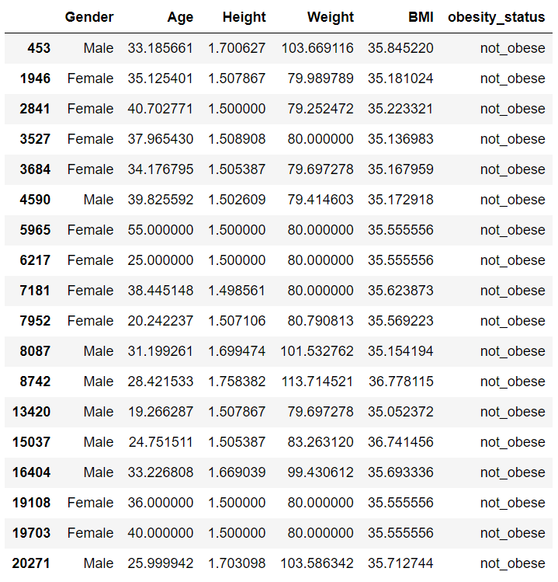
BMI Above 35 and Not Obese

Slide 23
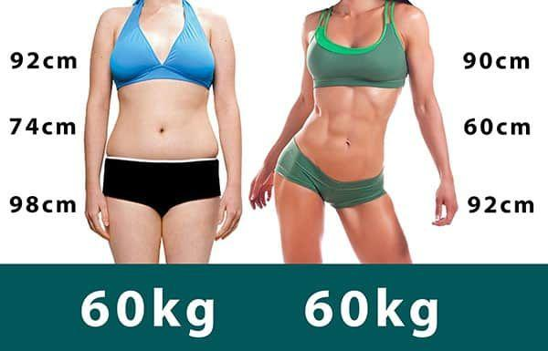
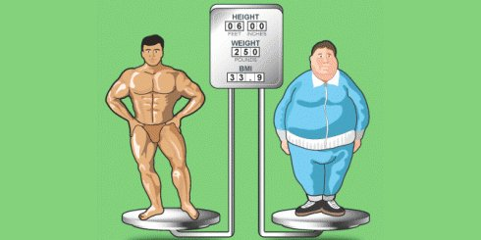
Other Measures / Factors
02 Obesity Model
Muscle Mass
Fat mass
Physical Activity
Waist Circumference
Age
Ethnicity
Notes:
Depending on your age, having a little extra weight can be healthy. Older people who are slightly overweight tend to live longer than leaner elderly people
African-Americans may have a higher BMI without the same health risks that a white person might have

Slide 24
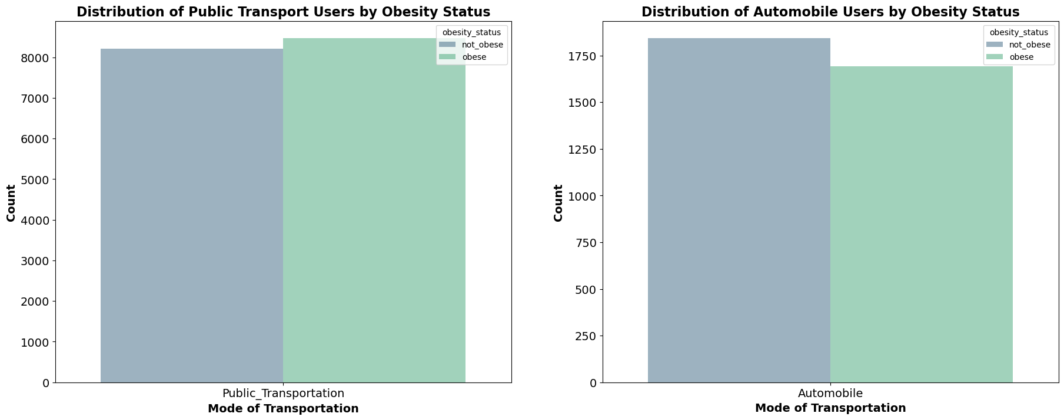
Distribution of Public Transportation Users and Automobile Users by Obesity Status
02 Obesity Model

Slide 25
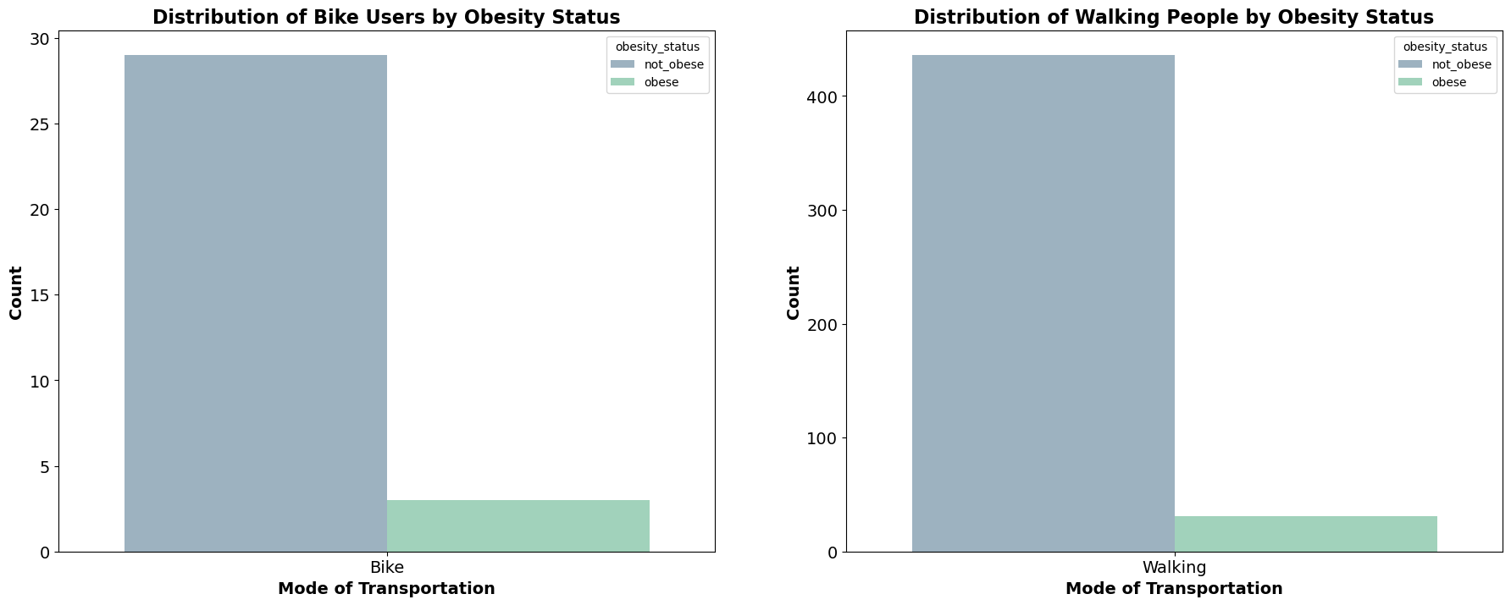
Distribution of Bike Users and Walking People by Obesity Status
02 Obesity Model

Slide 26
Obesity Model

Slide 27
Features
02 Obesity Model
17 Features:
Gender
Age
Height
Weight
Physical Activity Frequency
Mode of Transportation
Number Of Meal In A Day
Consumption of High Caloric Food
And other features…..

Slide 28
Base Models Comparison
02 Obesity Model
Model | Processing Time | Train Score | Test Score | Sensitivity
SVM | 2.3 s | 0.9266 | 0.9121 | 0.9078
Random Forest | 1.4 s | 1.000 | 0.9227 | 0.9188
XGBoost | 1.0 s | 0.9922 | 0.9291 | 0.9265
Catboost | 7.4 s | 0.9726 | 0.9299 | 0.9268

Slide 29
Base Models Comparison
02 Obesity Model
Model | Processing Time | Train Score | Test Score | Sensitivity
SVM | 2.3 s | 0.9266 | 0.9121 | 0.9078
Random Forest | 1.4 s | 1.000 | 0.9227 | 0.9188
XGBoost | 1.0 s | 0.9922 | 0.9291 | 0.9265
Catboost | 7.4 s | 0.9726 | 0.9299 | 0.9268

Slide 30
Hyperparameter Tuning
02 Obesity Model
Model | Processing Time | Train Score | Test Score | Sensitivity
Catboost | 7.4 s | 0.9726 | 0.9299 | 0.9268
Catboost Tuned | 5.7 s | 0.9541 | 0.9301 | 0.9271
✅
Hyperparameters:
Learning Rate = 0.07
Depth = 5
Iterations = 1500

Slide 31
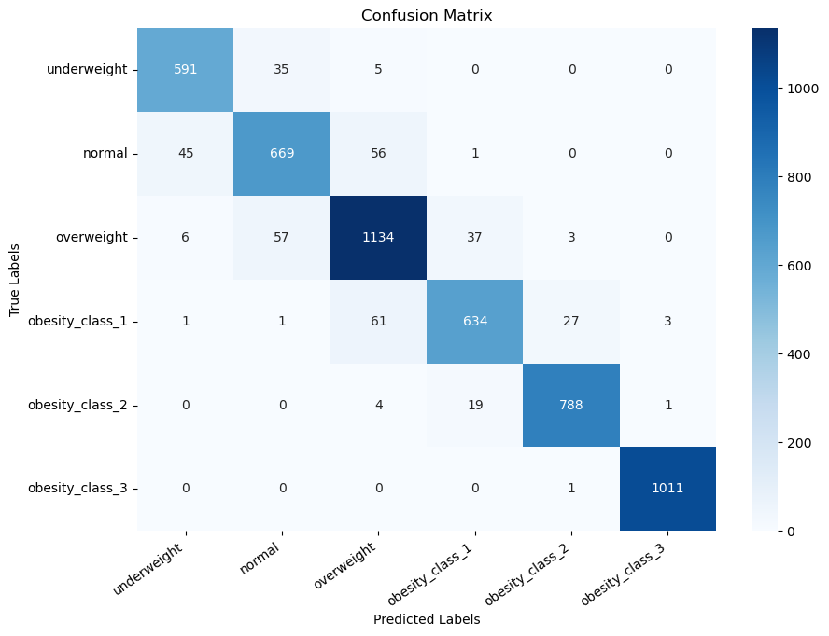
Tuned Confusion Matrix
02 Obesity Model

Slide 32
Tuned Confusion Matrix
02 Obesity Model
TP

Slide 33
Tuned Confusion Matrix
02 Obesity Model
TP
FN

Slide 34
Tuned Confusion Matrix
02 Obesity Model
TP
FN
FP

Slide 35
Tuned Confusion Matrix
02 Obesity Model
TP
FN
FP
TN

Slide 36
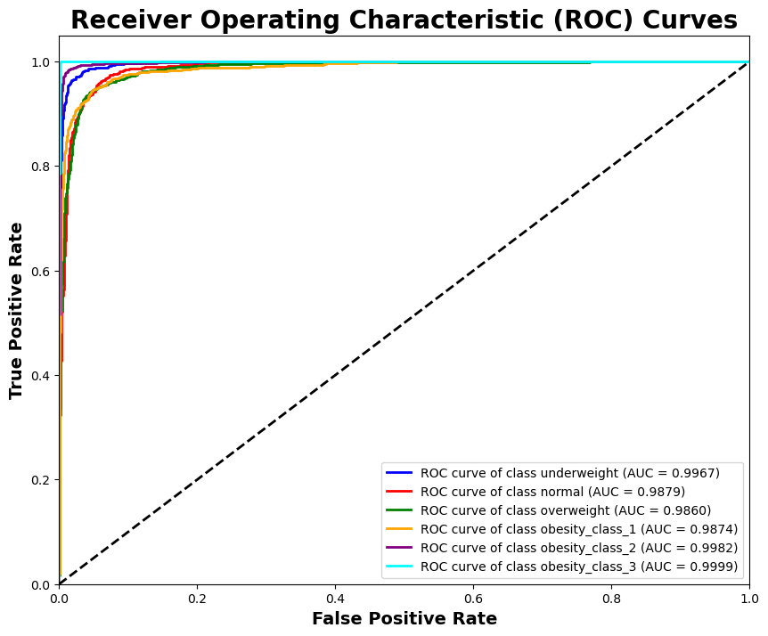
ROC AUC
02 Obesity Model

Slide 37
02 Obesity Model
Obesity Classification Model
George
Bernard
Obesity Class 2
Stroke Detection Model
CT Scan Image Stroke Detector

Slide 38
03 Stroke Detection Model
Obesity Classification Model
George
Bernard
Obesity Class 2
Stroke Detection Model
CT Scan Image Stroke Detector

Slide 39
Stroke Dataset
03 Stroke Detection Model

Slide 40
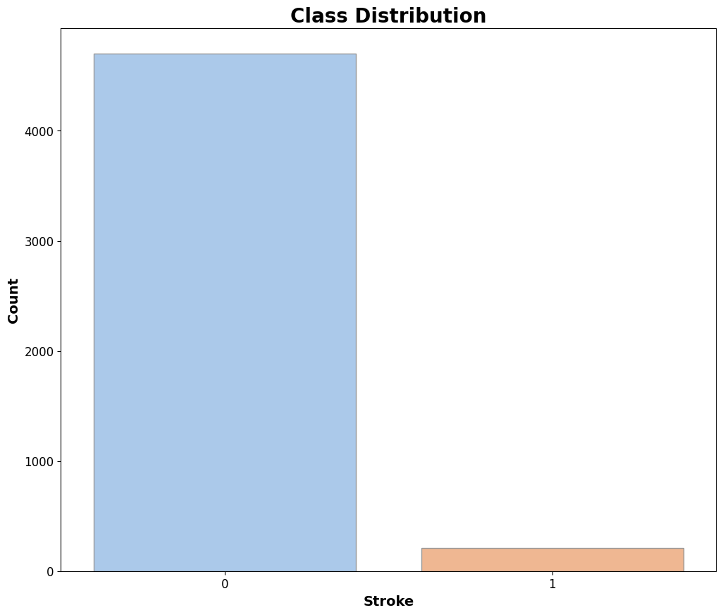
Stroke Dataset
03 Stroke Detection Model
Dataset was taken from Kaggle.
Dataset has around 5100 rows.
10 features
Dataset is imbalance.

Slide 41
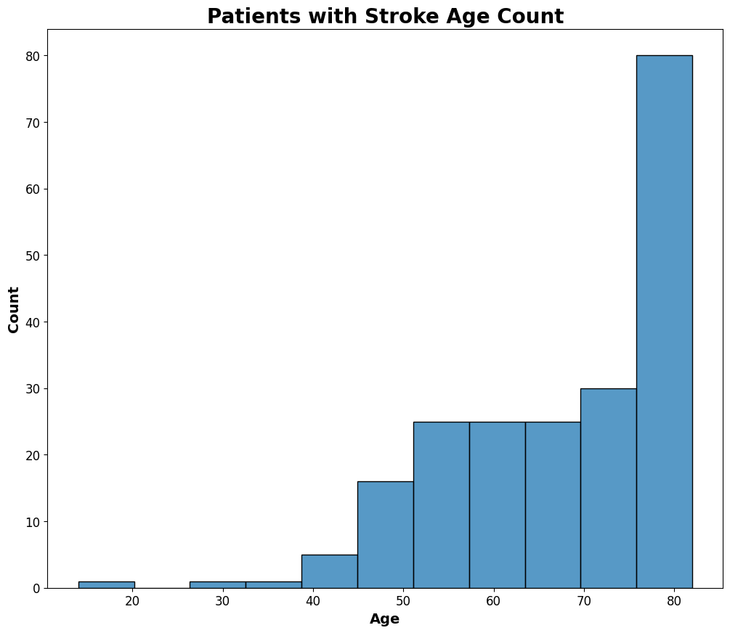
Analyzing the Data
03 Stroke Detection Model
Highest number of stroke patients were around age 75 and above.

Slide 42
Analyzing the Data
03 Stroke Detection Model
Highest number of stroke patients were around age 75 and above.

Slide 43
Analyzing the Data
03 Stroke Detection Model

Slide 44
Analyzing the Data
03 Stroke Detection Model
Decided not to remove her from the dataset.
Obesity Class 1 BMI 30 to 34.9 kg/m^2

Slide 45
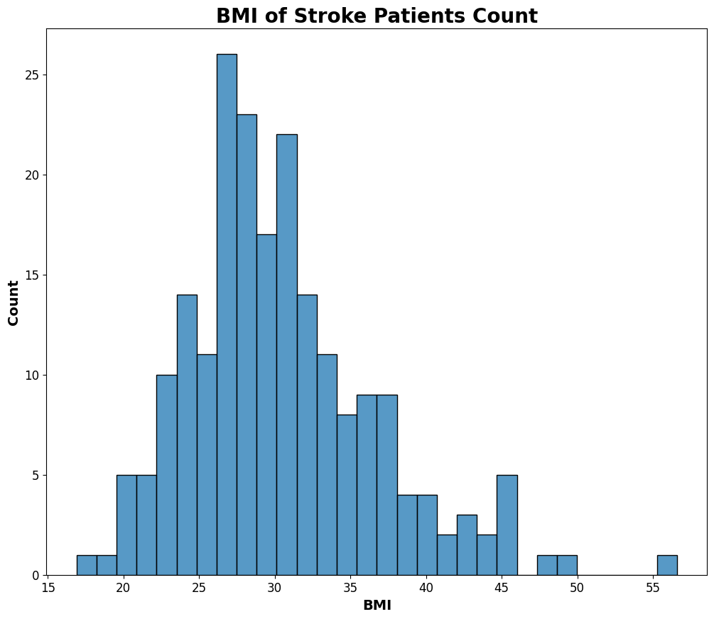
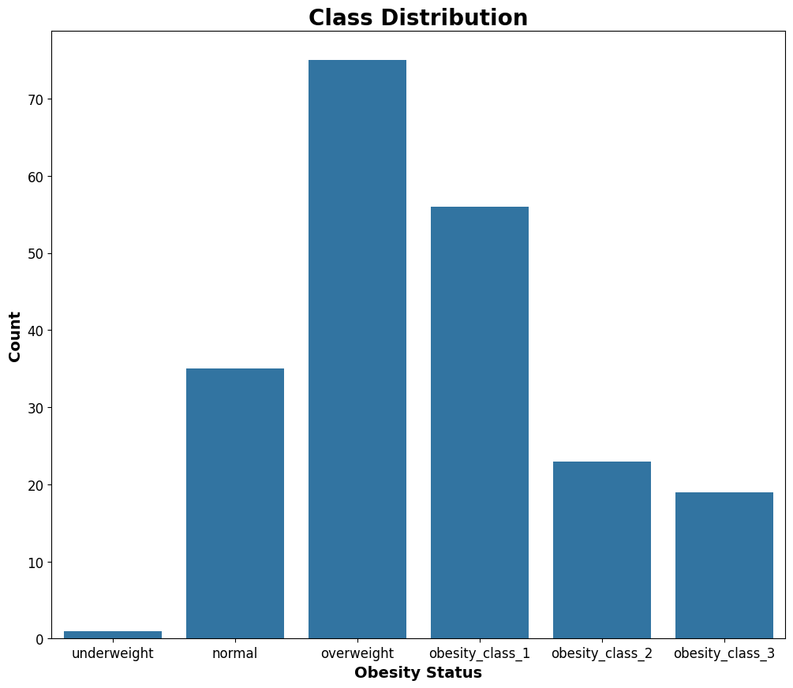
Analyzing the Data
03 Stroke Detection Model
Overweight : BMI greater than or equal to 25 to 29.9 kg/m^2
Obesity class 1 : | BMI 30 to 34.9 kg/m^2

Slide 46
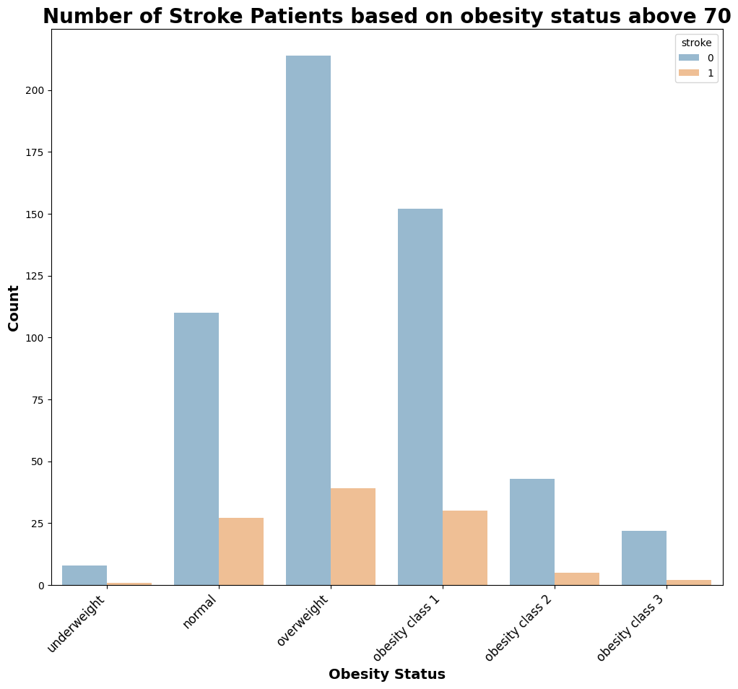
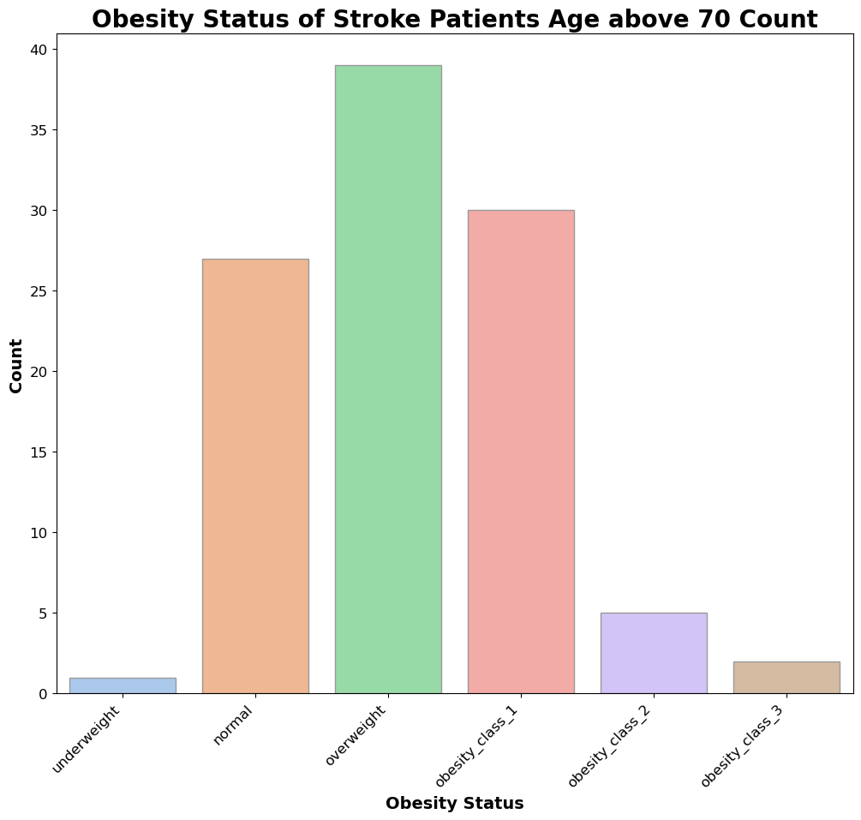
Analyzing the Data
03 Stroke Detection Model

Slide 47
Analyzing the Data
03 Stroke Detection Model

Slide 48
Analyzing the Data
03 Stroke Detection Model
Other Features
Gender
Hypertension
Heart Disease
Average Glucose Level
Smoking Status
Employment Status
Diabetic Status
Obesity Status (Classified by Obesity Model)

Slide 49
Analyzing the Data
03 Stroke Detection Model
Other Features
Gender
Hypertension
Heart Disease
Average Glucose Level
Smoking Status
Employment Status
Diabetic Status
Obesity Status (Classified by Obesity Model)
Obesity Classification Model

Slide 50
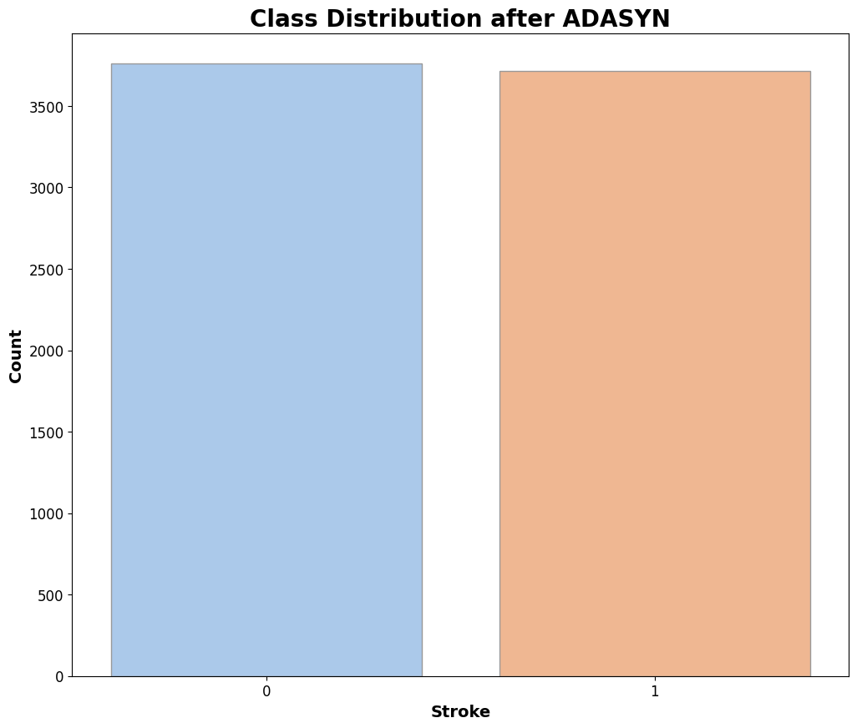
Rebalancing the Data (ADASYN)
03 Stroke Detection Model
Adaptive Synthetic Sampling (ADASYN)
Generate more synthetic examples in regions of the feature space where the density of minority examples is low, and fewer or none where the density is high.
Why oversample the minority? Machine learning algorithms tend to be biased towards the majority class because they aim to optimize overall accuracy. As a result, the minority class may be poorly represented in the model's predictions.

Slide 51
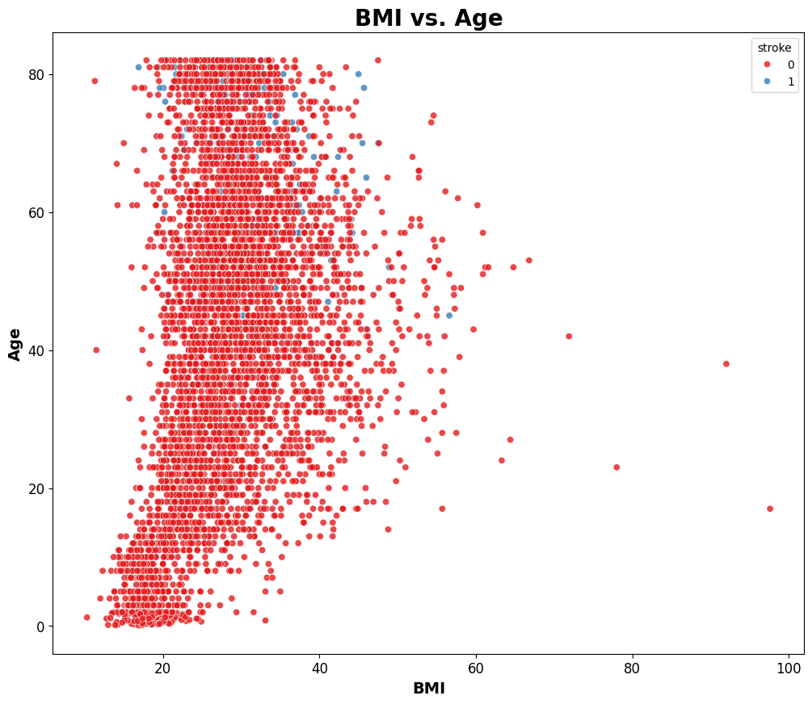
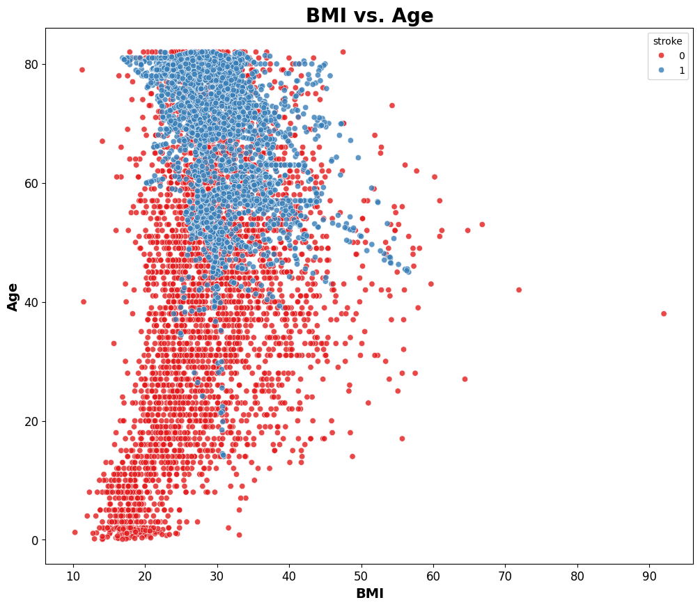
Rebalancing the Data (ADASYN)
03 Stroke Detection Model
Without Data Augmentation
With ADASYN oversampling

Slide 52
Stroke Detection Model
03 Stroke Detection Model

Slide 53
Base Model Comparison
03 Stroke Detection Model
Model | Processing Time | Train Score | Test Score | Sensitivity
Log Reg | 21 ms | 0.8120 | 0.7760 | 0.5714
KNN | 26 ms | 0.9317 | 0.8004 | 0.3095
Decision Tree | 44 ms | 1.0000 | 0.8625 | 0.1429
Bagging | 199 ms | 0.9968 | 0.8819 | 0.1667
Random Forest | 723 ms | 1.0000 | 0.8890 | 0.2143
AdaBoost | 237 ms | 0.8426 | 0.7709 | 0.4762
SVM | 1.01 s | 0.8616 | 0.7984 | 0.3571
XGBoost | 135 ms | 0.9941 | 0.9002 | 0.1667

Slide 54
Base Model Comparison
03 Stroke Detection Model
Model | Processing Time | Train Score | Test Score | Sensitivity
Log Reg | 21 ms | 0.8120 | 0.7760 | 0.5714
KNN | 26 ms | 0.9317 | 0.8004 | 0.3095
Decision Tree | 44 ms | 1.0000 | 0.8625 | 0.1429
Bagging | 199 ms | 0.9968 | 0.8819 | 0.1667
Random Forest | 723 ms | 1.0000 | 0.8890 | 0.2143
AdaBoost | 237 ms | 0.8426 | 0.7709 | 0.4762
SVM | 1.01 s | 0.8616 | 0.7984 | 0.3571
XGBoost | 135 ms | 0.9941 | 0.9002 | 0.1667

Slide 55
Hyperparameter Tuning
03 Stroke Detection Model
Model | Processing Time | Train Score | Test Score | Sensitivity
Log Reg | 21 ms | 0.8120 | 0.7760 | 0.5714
Log Reg Tuned | 2.86 s | 0.8107 | 0.7759 | 0.5952
XGBoost | 135 ms | 0.9941 | 0.9002 | 0.1667
XGBoost Tuned | 2.9 s | 0.8107 | 0.5896 | 0.8571
Despite the dataset being balanced, there’s only so much it can provide the model to train for it to be accurate.
Decided to prioritize Sensitivity.
Crucial for conditions like strokes, where failing to predict an actual positive case can have serious consequences. High sensitivity means the model is effective at catching most positive cases.
Notes:
Sensitivity aka True Positive Rate is the proportion of Stroke samples that were correctly classified.

Slide 56
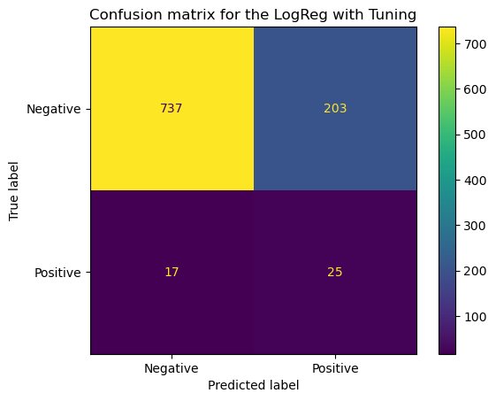
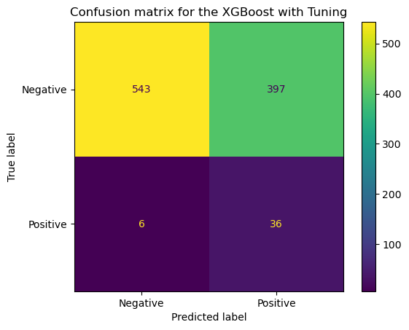
Tuned Confusion Matrix
03 Stroke Detection Model
Sensitivity (recall): The proportion of true positives predictions out of all actual positive instances.

Slide 57
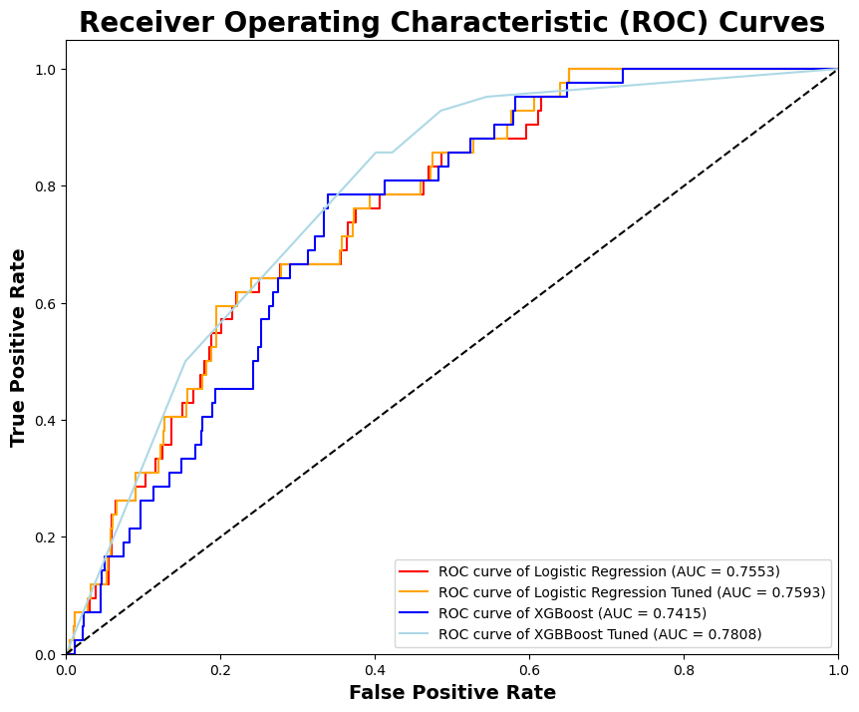
ROC AUC
03 Stroke Detection Model
Best performing Model
(XGBoost)

Slide 58
Hyperparameter Tuning
03 Stroke Detection Model
03 Stroke Detection Model
Model | Processing Time | Train Score | Test Score | Sensitivity
Log Reg | 21 ms | 0.8120 | 0.7760 | 0.5714
Log Reg Tuned | 2.86 s | 0.8107 | 0.7759 | 0.5952
XGBoost | 135 ms | 0.9941 | 0.9002 | 0.1667
XGBoost Tuned | 2.9 s | 0.8107 | 0.5896 | 0.8571
✅
Sensitivity (recall): The proportion of true positives predictions out of all actual positive instances.

Slide 59
04 CT Scan
Stroke
Detector
Obesity Classification Model
George
Bernard
Obesity Class 2
Stroke Detection Model
Stroke Probability : 76.5%
CT Scan Image Stroke Detector

Slide 60
04 CT Scan
Stroke
Detector
Obesity Classification Model
George
Bernard
Obesity Class 2
Stroke Detection Model
Stroke Probability : 76.5%
CT Scan Image Stroke Detector

Slide 61
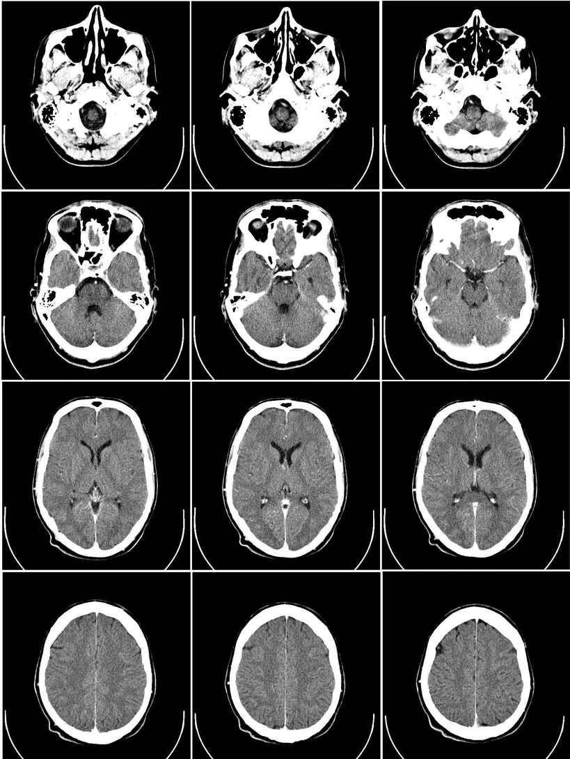
CT Scan images Model
04 CT Scan
Stroke
Detector

Slide 62
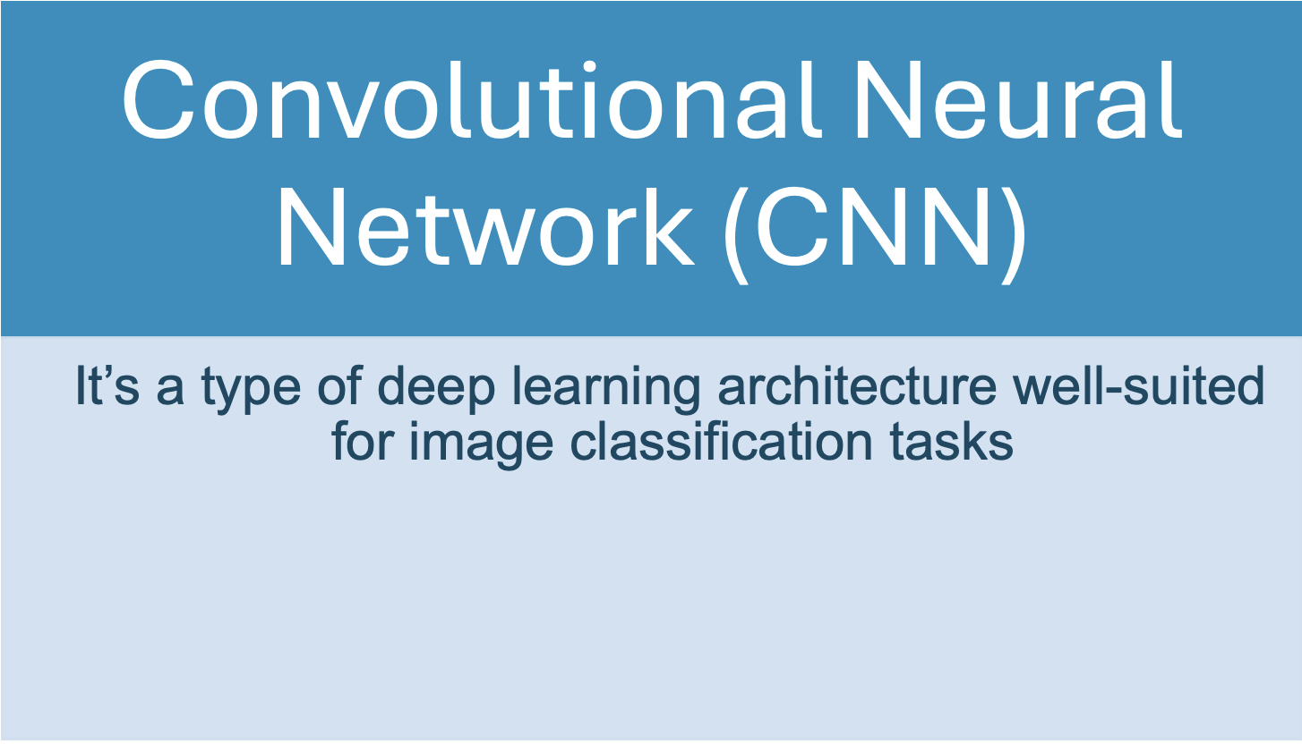
Model used for CT scan images
04 CT Scan
Stroke
Detector

Slide 63
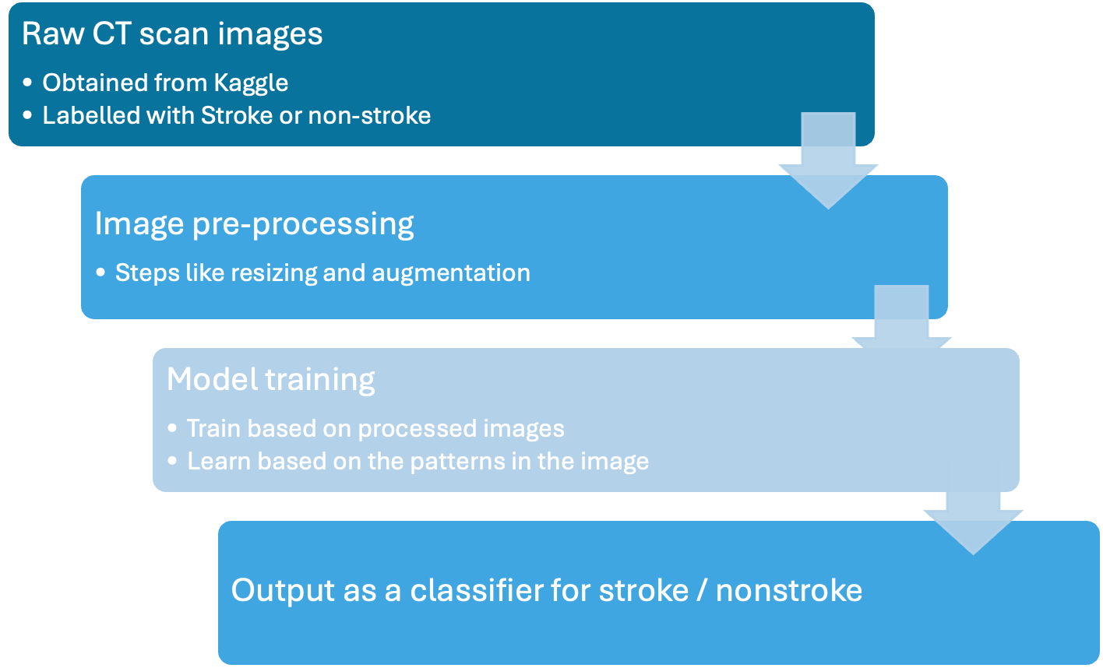
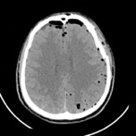
How does CNN works?
04 CT Scan
Stroke
Detector

Slide 64
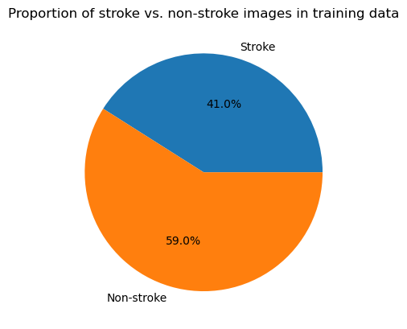
CT scan images
04 CT Scan
Stroke
Detector
Images were taken from Kaggle.
Training set have around 1,843 images
41% is stroke and 59% is non-stroke

Slide 65
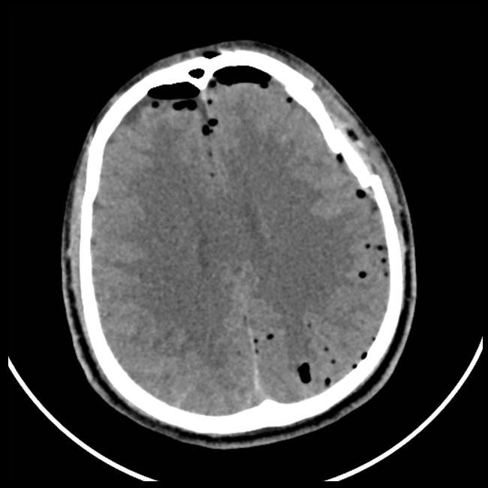
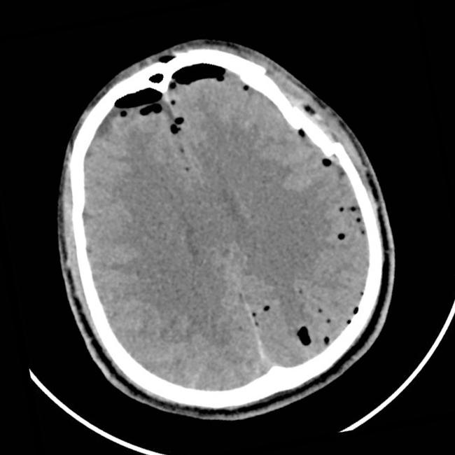
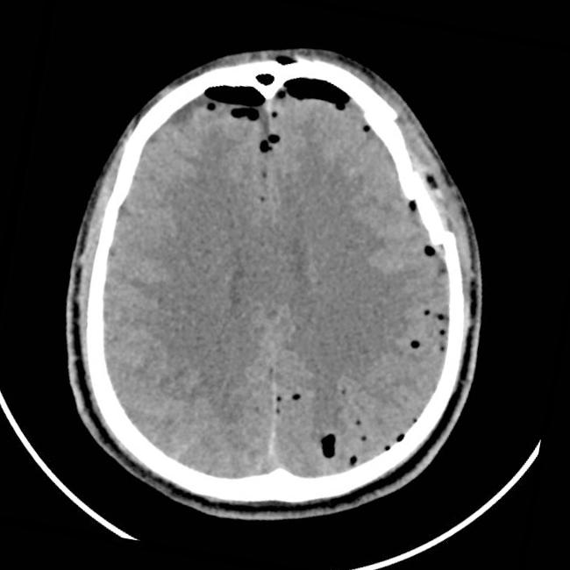
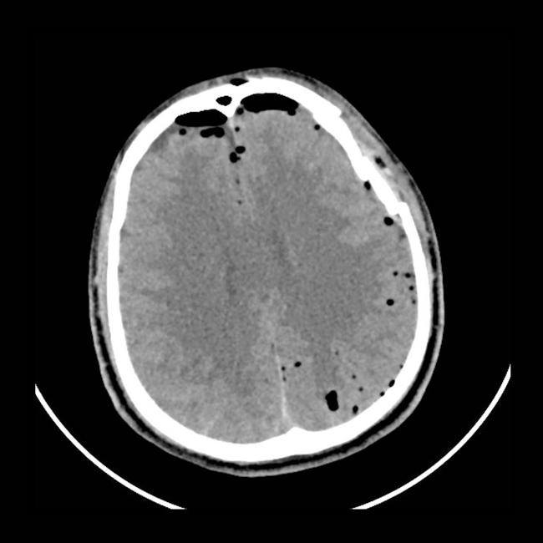
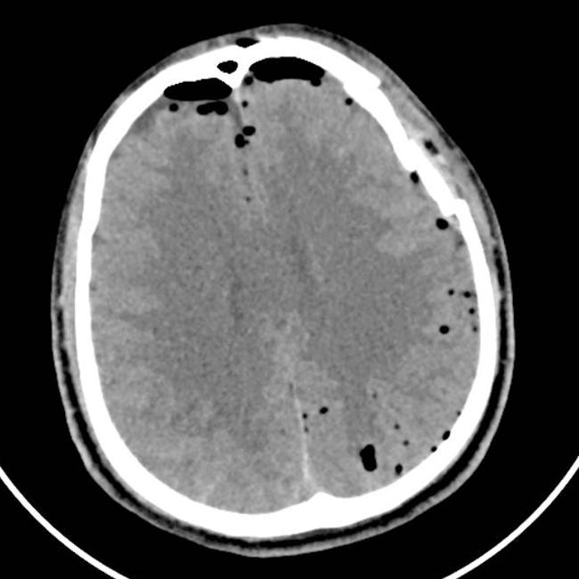
Image pre-processing (Augmentation)
04 CT Scan
Stroke
Detector
Original
Rotate -10°
Rotate 10°
Scale -10%
Scale +10%

Slide 66
Model Training
04 CT Scan
Stroke
Detector
Model Architecture | Sequential
No. of layers | 9
Total parameters | 7,466,177
Optimizer | Adam (Learning rate 0.001)
Loss function | Binary Cross-entropy
Metrics | Sensitivity

Slide 67
Model Score
04 CT Scan
Stroke
Detector
Model Scores
Sensitivity
0.9615
Accuracy
0.9428

Slide 68
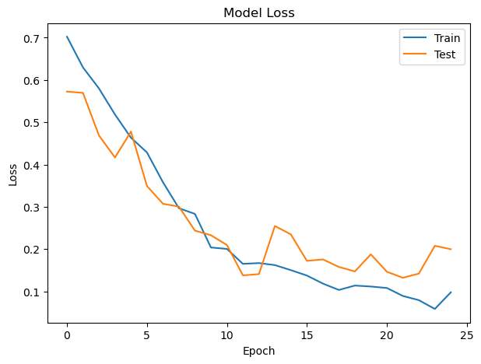
Loss over training epochs
04 CT Scan
Stroke
Detector

Slide 69
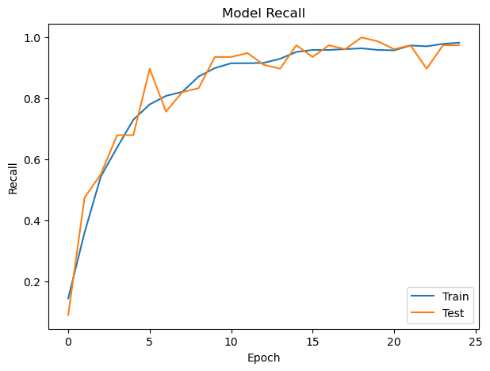
Recall over training epochs
04 CT Scan
Stroke
Detector

Slide 70
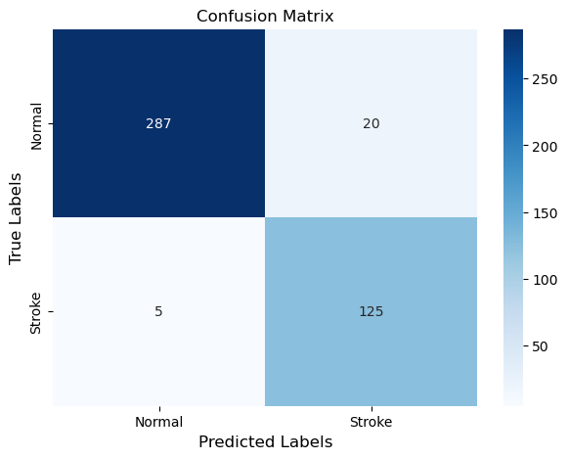
Confusion Matrix
04 CT Scan
Stroke
Detector

Slide 71
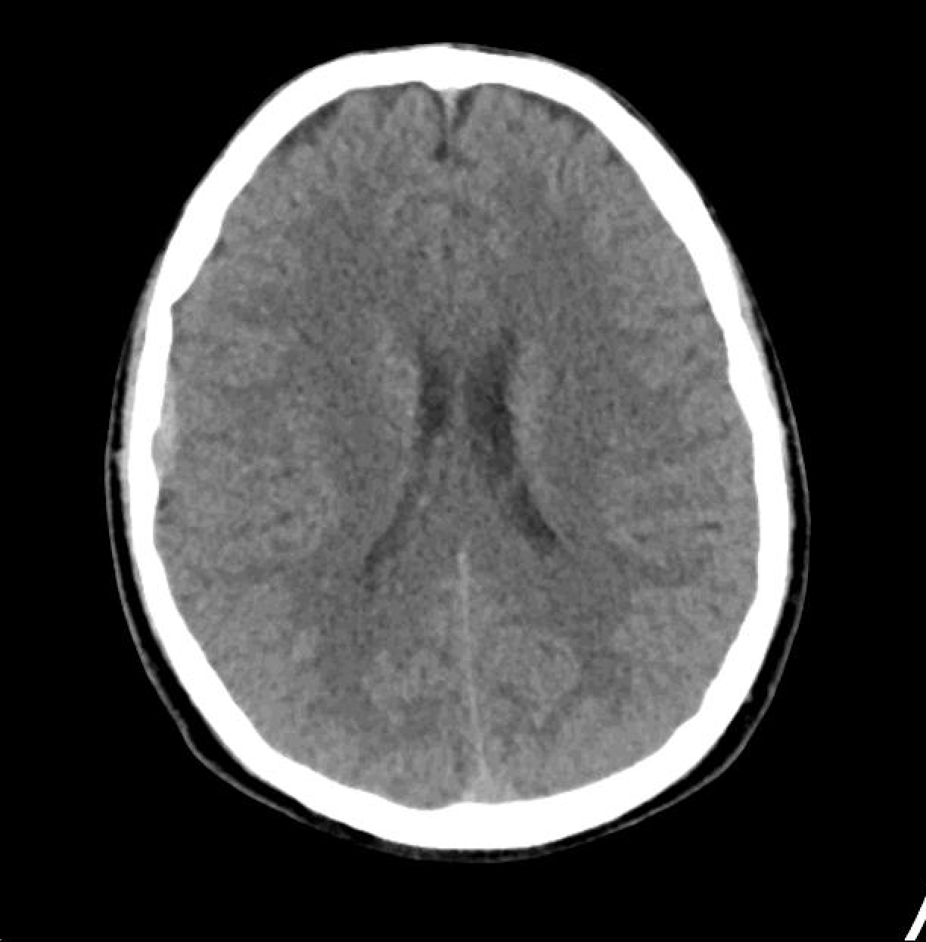
Test 1 - Risk of Stroke
04 CT Scan
Stroke
Detector
Model prediction | Actual
✅
98.41%
Stroke

Slide 72
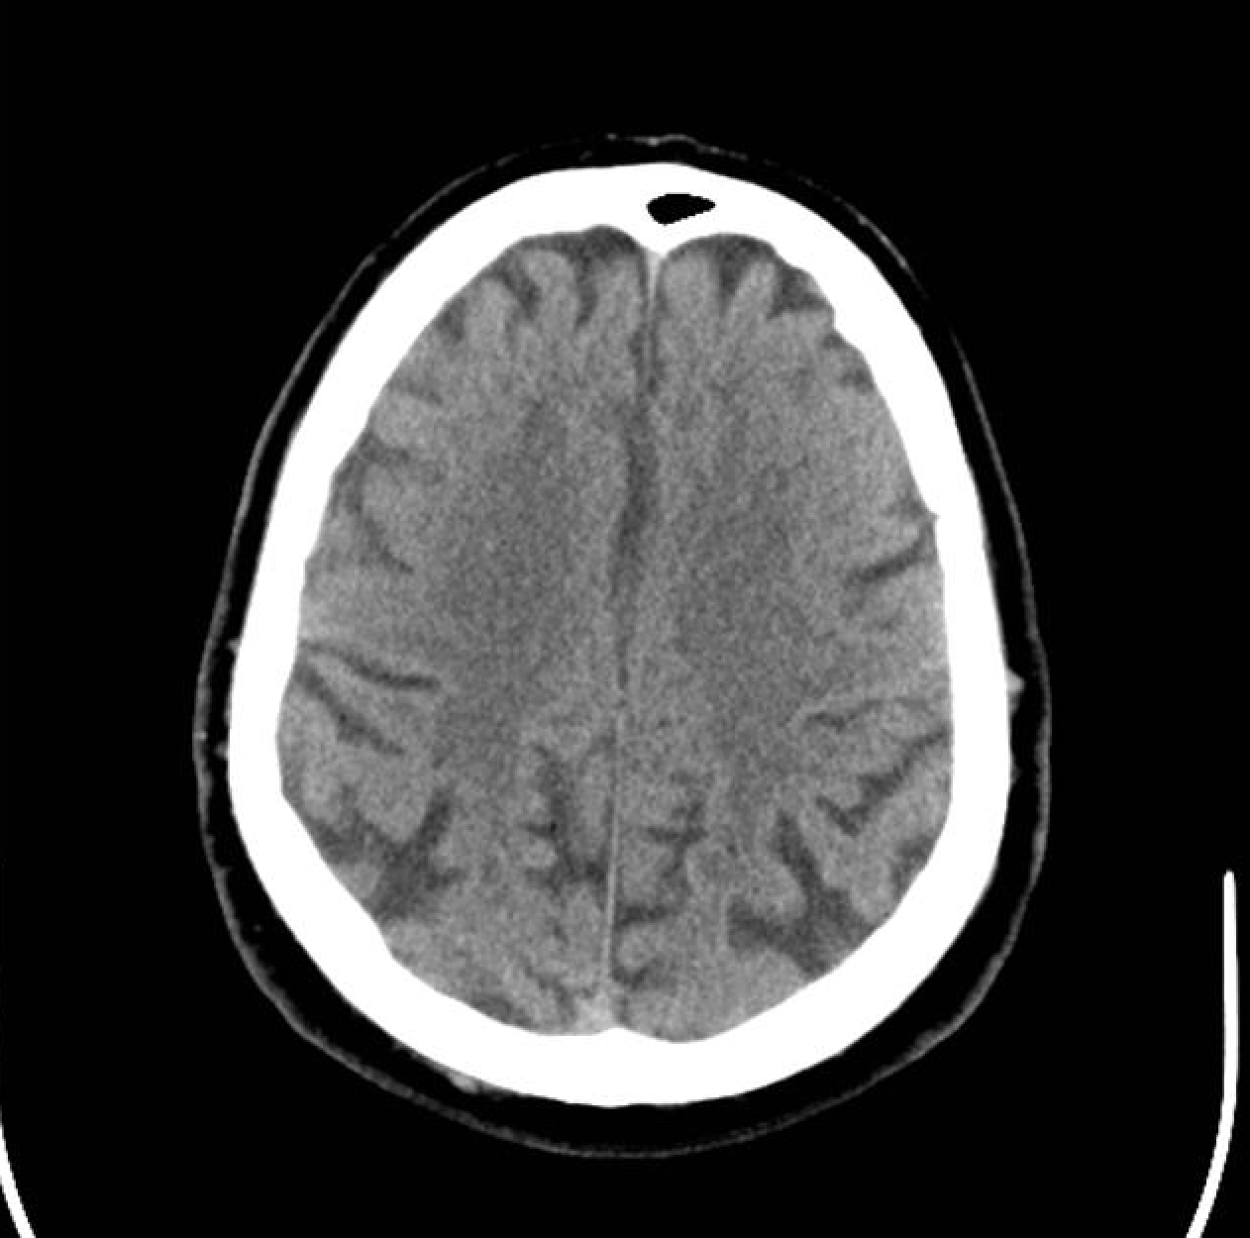
Test 2 - Risk of Stroke
04 CT Scan
Stroke
Detector
Model prediction | Actual
0.04%
Non- stroke
✅

Slide 73
04 CT Scan
Stroke
Detector
Obesity Classification Model
George
Bernard
Obesity Class 2
Stroke Detection Model
Stroke Probability : 76.5%
CT Scan Image Stroke Detector
Stroke Probability : 98.41%

Slide 74
Cost Benefits Analysis
05 Cost Benefits Analysis

Slide 75
05 Cost Benefits Analysis
Implementation Cost
Development cost
Implementation cost
Maintenance
Data collection and cleaning.
Personnel costs for data scientists and engineers.
Computational resources for training.
Integration into existing healthcare systems
Cost of obtaining new CT scan images for risk prediction.
Training for staff using the model.
Regular model updates to ensure accuracy with new data.
Technical support and troubleshooting.

Slide 76
05 Cost Benefits Analysis
Hospital Implementation Benefit
03
Saving costs associated with doctor's time.
The app will be able predict the risk of getting stroke without requiring a doctor's diagnosis, allowing nurses or clinical assistants to use it and avoid occupying doctors’ time.
Early detection benefits for patients
Potential cost savings by treating stroke early, for example, minimization of long term care.
01
02
Save on operational cost for hospital healthcare facilities
Including equipment cost, manpower cost and etc.

Slide 77
05 Cost Benefits Analysis
Patient Cost & Benefits
Without App Implementation
With App Implementation
Hospital cost $5,000 - $15,000
Rehabilitation cost $6,000 - $12,000 for 6 months
If the patient gets stroke, he will lose his income for 6 months or longer, $30,000 or more
Save hospitalization and rehabilitation cost.
Cholesterol and high blood pressure medicine $1,000 - $1,200 a year.
Will be able to continue working and have income.

Slide 78

06
Streamlit
Bernard
George

Slide 79
Limitation
07 Limitation

Slide 80
07 Limitation
Limitation of the models
Limited Training Data
Due to limited data, the model might be overly specific to the training data (overfitting) or lack the complexity to capture the data's patterns (underfitting), hindering its ability to generalize well to unseen examples.
Black box models
Complex models like neural networks can be highly effective but often lack clear explanations for their decisions. This can make them unsuitable for domains where understanding the reasoning behind a prediction is crucial.

Slide 81
Recommendation
08
Recommendation

Slide 82
08
Recommendation
Recommendation
Recommendation
We need to find more training data to improve our models. Here are some ways to address dataset limitations in specific areas:
Obesity: For the obesity dataset, we could find more data, for example waist circumference and fat mass. This would make the model even more accurate.
Stroke: The current stroke dataset has a minority of stroke-positive examples. Finding a bigger dataset with a more balanced distribution could improve the model's performance.
CT Image scan: We can improve the accuracy of our model by finding more CT image scans for training

Slide 83
Conclusion
09 Conclusion

Slide 84
09 Conclusion
Recap: Problem Statement
The healthcare system faces a challenge in quickly identifying patients at risk of stroke upon arrival at the emergency department (A&E), despite standardized triage protocols. Swiftly discerning stroke risk based on initial health particulars such as obesity is difficult, leading to delays in referrals to specialists for preventive measures.
How might we help A&E identify patients at risk of stroke easier?
George
Bernard

Slide 85
09 Conclusion
George
George will now be able to quickly diagnose potential stroke patients like Bernard at A&E.
Get a quick general prediction from the CT scan of the brain.
Obesity Classification Model
Stroke Detection Model
Bernard
CT Scan Image Stroke Detector

Slide 86
Thank you
Thank you

Slide 87
Q&A
Q&A

